Slide 2

The Austin Region:
The Game Changer of Texas

Slide 3

Stacy Schmitt
Senior vice president
Communications and External Affairs

Slide 4

Who are we?
Opportunity Austin is a five-year regional economic development strategy aimed at fostering job-creating investment across the Austin region.
Our work has created economic resilience not just through job creation but through diversification and standing up new sectors of the economy and we are finding success every day.

Slide 5
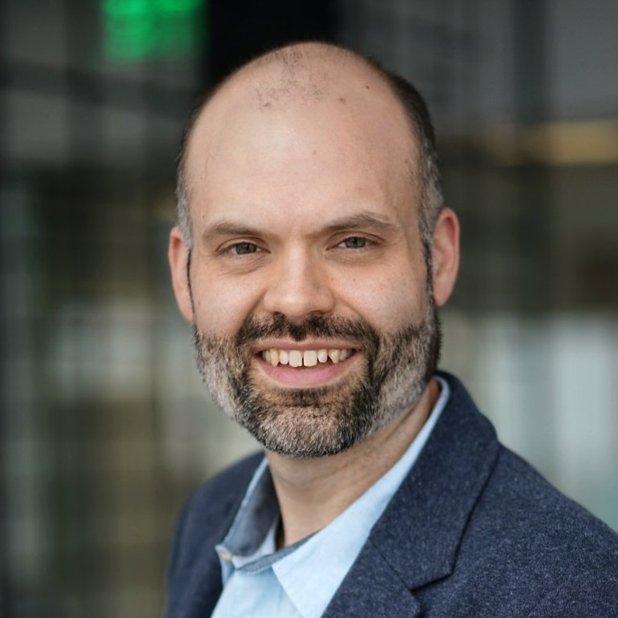
Tony DeLisi
Senior manager of Economic Development, Ernst & Young

Slide 6
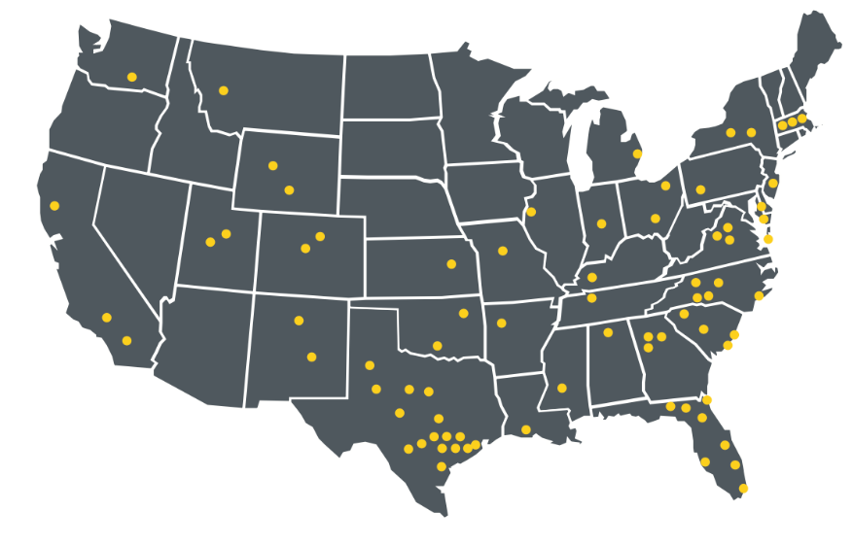
EY | Economic Development Advisory Services
Global firm with a robust government and public sector practice
One of the nation’s largest dedicated economic development practices with more than 300 strategic planning clients across the country
Experienced team that gets Greater Austin and is committed to its success – with 250 employees in the region and numerous private customers

Slide 7





Roadmap for Opportunity Austin 5.0
October - November
December - March
2023 & Beyond
Month
Opportunity Austin’s investments in Greater Austin have resulted in unparalleled growth and new opportunities across the region
An intentional strategy with a long-term vision leads to sustained, transformative growth for all of Greater Austin
Opportunity Austin keeps up intentional work that makes the region thrive
Implement
Strategize
Engage
Drafting 0A 5.0 framework & strategy
Steering committee workshops
Strategy finalization
Ongoing work
Business recruitment
Business retention and expansion
Advocacy and investment
Interviews, focus groups, and survey
Identify vision, priorities and new initiatives
Process
Discover
Project setup
Landscape review
Data analysis
Steering committee workshop
Housing
Innovation
Quality of life
Talent & education
New technology
Supply chains
Mobility
Infrastructure
Leadership

Slide 8
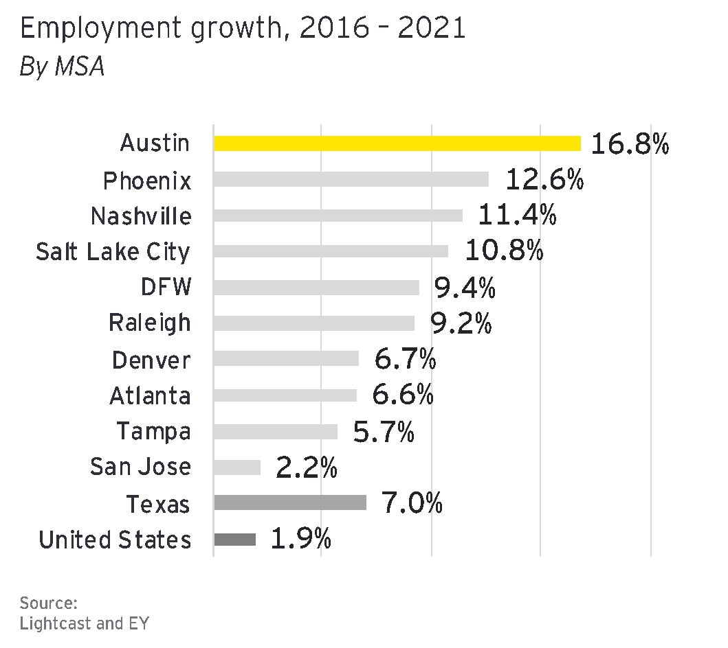
What the data tells us
Leading in employment, population, and GDP growth
Thriving innovation ecosystem
Education and labor force participation higher than ever
Losing our advantage in affordability: housing / talent

Slide 9

We listened to you
We engaged 300 investors, partner organizations and key regional stakeholders
Survey says, What are the top 3 issues affecting business growth in Greater Austin?
  Workforce availability
  Housing affordability
  Development Regulations / Public Safety

Slide 10

We looked at leading practices
How are competitor regions positioning themselves to catch up with Greater Austin?
  DFW
  Denver
  Houston
  Nashville
  Phoenix
  San Diego

Slide 11
The results: Opportunity Austin 5.0
      The Vision
      Greater Austin is a vibrant, globally-connected region that drives inclusive economic prosperity through innovation, investment and collaboration.

Slide 12
Opportunity Austin 5.0
      The Priorities
      The Goals
Greater Austin’s economy is diverse, resilient and prosperous.
Greater Austin is a top global destination for businesses and investment.
Companies in Greater Austin have access to the talent they need.
Greater Austin invests in quality of life that makes it attractive to people and businesses.
Enhancing economic resilience
Connecting to global markets
Filling the talent pipeline
Improving quality of life

Slide 13

Enhancing Economic Resilience
Refocus recruitment on emerging industries (Life Sciences, Advanced Manufacturing, Aerospace & Defense, Clean Technology, EV/Automotive)
Develop and market emerging industry assets
Continue to enhance BR&E program
Tell the story about economic development incentives
Game Changer: Innovation District

Slide 14

Connecting to
Global Markets
Raise awareness of the Austin Region through expanded marketing efforts to recruit internationally
Develop a structured “soft landing” program for international organizations
Support regional business expansion into foreign markets
Game Changer: International Investment Fund

Slide 15

Filling the Talent Pipeline
Focus on both College and Career readiness programs
Continue efforts to connect regional students to in-demand career pathways Direct to Work
Continue FAFSA to meet higher ed industry needs
Prioritize customized training
Game Changer: Make it Movement Campaign

Slide 16

Improving Quality of Life
Work to help improve housing development and density
Invest more in regional mobility projects
Focus on critical infrastructure for the future
Address public safety
Game Changer: Regional housing strategy

Slide 17

Notes:
Call to action: pivotal moments in Austin’s history, as we enter the global stage, etc

Slide 18
Panel Discussion:
Life Sciences in the Austin Region

Slide 19
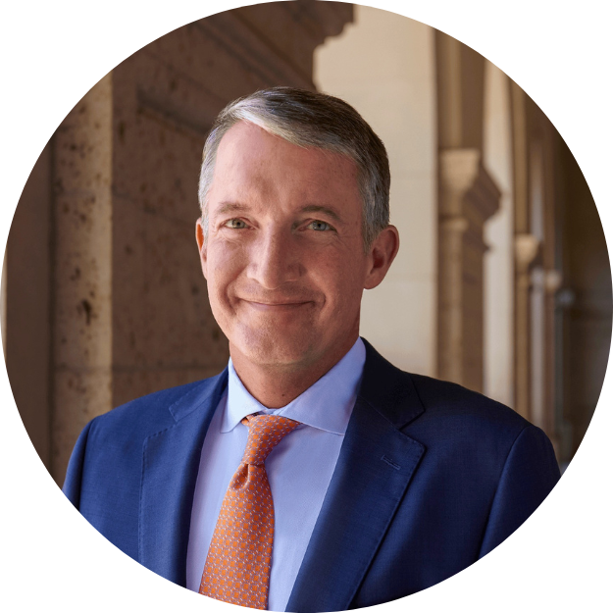




Moderator
Jay Hartzell
Matt Schwab
Jordan Robinson
Aaron Ali, M.D.
Kristin Marcum
President of the University of Texas at Austin
Co-founder
Karlin Real Estate
President & CEO
Round Rock Chamber
Co-founder & CEO
MedtoMarket
Owner & CEO
ECPR Texas

Slide 20
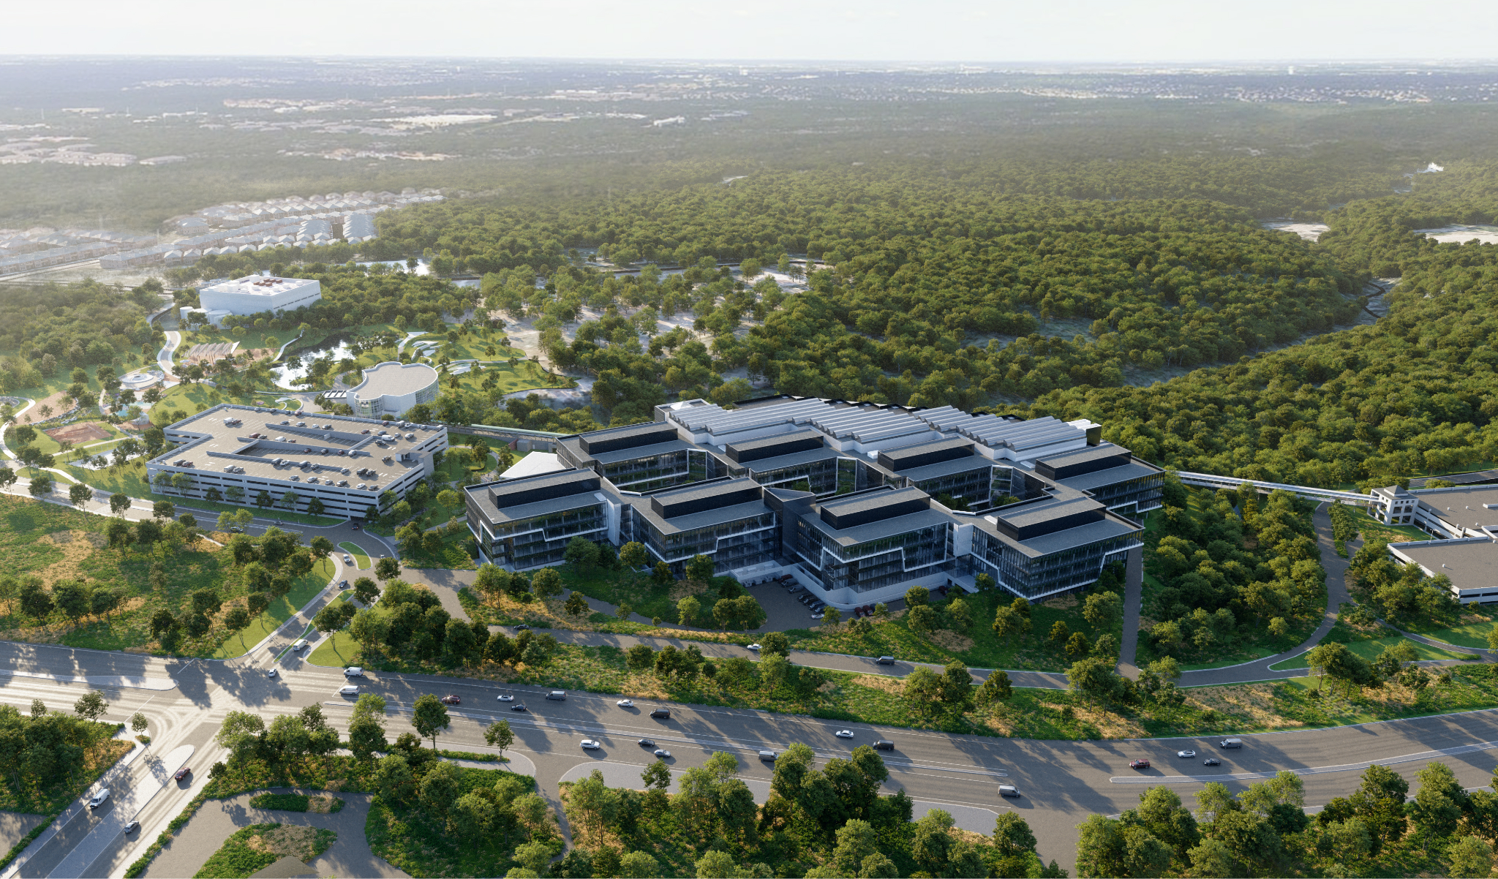


Slide 21
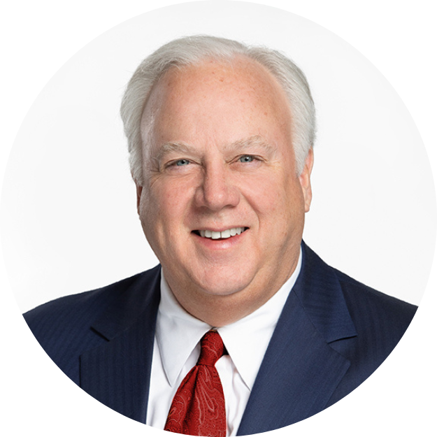
Gary Farmer
Chairman & Interim CEO
Opportunity Austin

Slide 22
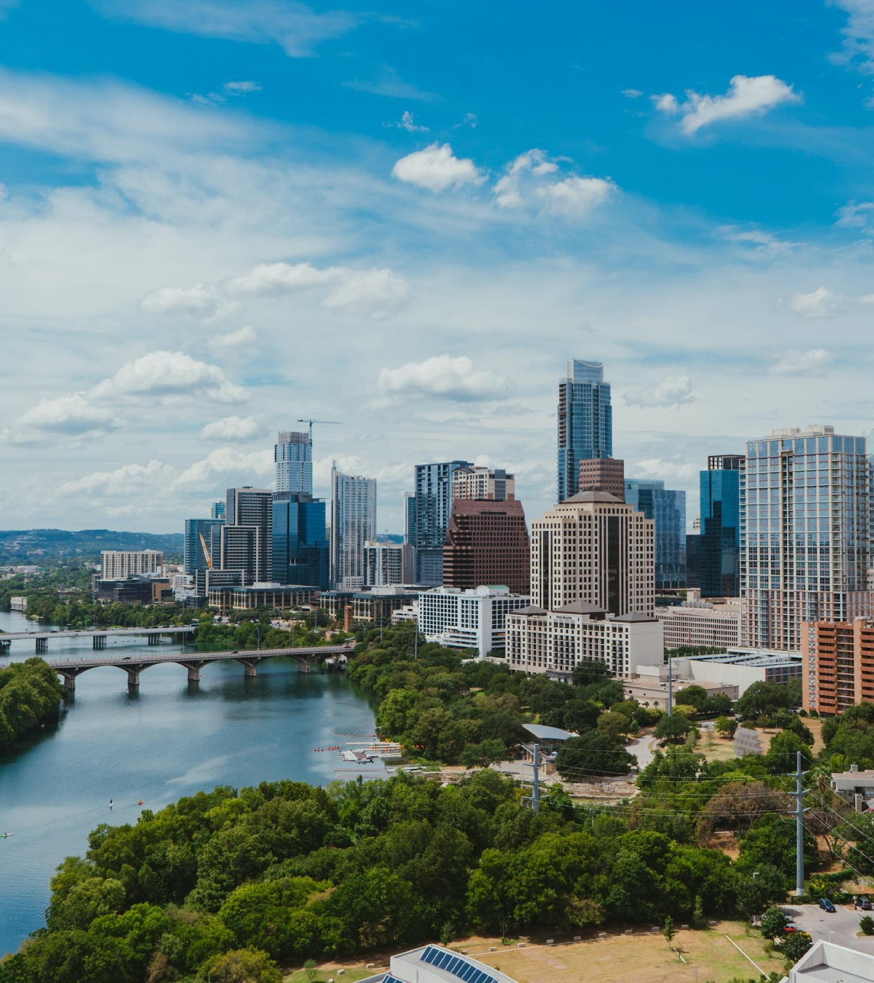
The Austin Region Now
The Austin Region is the 22nd-largest metropolitan area economy, with regional gross domestic product of approximately $200 billion.
827 new companies recruited to the region.
1,433 companies expanded in the region.
640,400 new jobs created in the region.
$53 Billion of new wages brought to the region.

Slide 23
Our Competition
Organization | Total Revenue ($) (2021) | Regional Population | Per Capita
Greater Raleigh EDGE | $4.3 million | 1.45 million | $2.97
Greater Phoenix Economic Council | $7.3 million | 4.95 million | $1.48
Prosperity 2030 (Nashville, Tenn) | $6.1 million | 2.1 million | $2.90
One Columbus (Oh) | $8.6 million | 2.15 million | $4.00
Kansas City Area Development Council | $6.2 million | 2.2 million | $2.80
Forward Oklahoma City | $5.1 million | 1.4 million | $3.64
Houston Next (Greater Houston P-ship) | $9.7 million | 7.34 million | $1.32
Forward Atlanta | $9.1 million | 6.1 million | $1.49
Charlotte Regional Business Alliance | $6.2 million | 2.7 million | $2.30
Opportunity Austin | $6 million | 2.2 million | $2.73

Slide 24













5.0 Investors

Slide 25
OA Solicitation Council
Chris Beck, Baylor, Scott and White
Bill Black, Horizon Bank
Keith Donahoe, Southside Bank
Gary Farmer, Heritage Title
Greta Goldsby, Drenner Group
Steven Gonzalez, PNC Bank
Claire Harrison, Texas Capital Bank
Tim Hendricks, Cousins
Dave Knoll, Ryan Properties
Chuck Lipscomb, JE Dunn Construction
Eric Marcella, Balcones Real Estate
Taylor McHargue, Aquila
Nick Moulinet, DPR
Dominic Padilla, White Construction
Kyle Parks, Maxwell Locke & Ritter LLP
Stephanie Perryman, Regions Bank
Chris Shields, Horizon Bank
Taylor Steed, 4T Realty
John Henry Swingler, LV Collective
Pete Winstead, Winstead PC

Slide 26
OA Steering Committee
Kristy Attaway, Hill & Wilkinson General Contractors
Chris Beck, Baylor Scott & White Central Texas Foundation
Denise Bradley, St. David’s Healthcare
Emily Chenevert, Austin Board of REALTORS
Jeff Coddington, JLL Capital Markets
Bryan Cumby, Cumby Group, LLC
Gary Farmer, Heritage Title
Pat Feigley, PIMCO
Justin Garrett, Balfour Beatty
Rudy Garza, GarzaEMC
Claire Harrison, Texas Capital Bank
Dillan Knudson, PNC
Pamela Madere, Jackson Walker LLP
Dr. Molly Beth Malcolm, Austin Community College District
Kristin Marcum, ECPR Texas
Mike McGlashan, Karlin Real Estate
Carlotta McLean, Peregrine Land Investments
Nick Moulinet, DPR Construction
Anna Panossian, Circuit of the Americas
David Putman, Aquila Commercial
Steve Smith, Truist
Taylor Steed, FourT Realty
Jim Susman, STG Design
Talley Williams, Metcalfe Wolff Stuart & Williams, LLP
Doug Wilson, SH 130 Concession Company
Keith Zimmerman, Cushman & Wakefield

Slide 27
Thank you for making the Austin Region the game changer of Texas!

