Slide 1
Life sciences in the Austin region
Discussion document
May 2024

Slide 2




The Austin region has the key ingredients for a thriving life sciences ecosystem
Life sciences is a multi-trillion dollar market with double digit annual growth projected over the next decade
Austin is the fastest growing MSA by GDP, driven by an over 30% increase in population since 2010
Austin has unmatched assets in talent and research to spur the success of the life sciences ecosystem
Source: Moody’s Analytics, Evaluate Pharma, Statista, HRI, Evaluate MedTech, Cowen, Market Research, Expert Interviews

Slide 3

Get to know the Austin region
2.4M
Population of the Austin metropolitan area
#26
Largest metro in the United States
3rd
Highest labor force participation
160K+
University students at 25 area colleges and universities
4th
Highest educational attainment among top 50 metros in the US
Source: Lightcast
3

Slide 4





The Austin region has unique assets that will fuel the growth of the life sciences ecosystem
Network of private and public institutions
Multi-disciplinary research
Home to over nearly 300 life sciences-related companies with over 21K employees
UT Austin, a top 10 public university, located minutes from downtown Austin
~$1B life sciences research funding through academic and corporate institutions
~350 life sciences patents issued in the past three years
Expansion of healthcare network
Premium real estate assets
Pipeline of high-performance, purpose-built life sciences space throughout Austin with 1.5M+ SF of life sciences facilities under construction
$2.5B investment to launch the UT Austin Medical Center
Major expansions of hospital systems, including #1 cancer center MD Anderson to Austin
Source: Press search, USPTO, NSF HERD

Slide 5




Why the Austin region is the right place for your life sciences business
A shared vision among stakeholders
Foundation in place for life sciences innovation
Strong foundation in tech
Talent as an advantage
Vibrant region with continued growth
Key stakeholders across the Austin region have developed a shared vision to develop the region as a life sciences hub
The Austin region has proven strengths in technology and tech-adjacent fields (e.g., computational science) that can be translated into life sciences
Large universities (e.g., UT Austin, Texas State) graduate talent in life sciences-specific fields; the Austin region has positive net migration from either coast
The Austin region ranks #6 in VC funding per capita in the US with strong innovation assets (e.g., incubators, accelerators)
The quality of life is unparalleled and leaders continue to advocate to make the Austin region attractive to people and businesses
Source: Pitchbook, press search
Notes:
5

Slide 6
Austin leaders have aligned on a vision to expand the life sciences ecosystem in the region
“If you think about Austin as you know and love it, this is that technology hub, that place where a venture capitalist, innovators, creators have all come together. And I would argue now is the time for that to extend to the life sciences… I know the city is excited about it. I know the business community is excited about it. Now, one of the ways that we can rally behind this idea is with an academic medical center, with a top medical school in conjunction with the other assets of this University to really make Austin the next hub for life science technology and innovation”
“We are a region of communities. And I’m excited that frameworks like the health and life science ecosystem are adopting a hub and spoke approach – opening doors of opportunity for the workforce in Travis County and beyond”
Sarah Eckhardt², Travis County Judge
“Our rising Innovation District brings new strengths in health and life sciences together with existing capabilities in engineering and data analytics. It is the convergence of one of the country’s pre-eminent academic institutions and a vibrant landscape of companies, supercharged by Austin’s creative and entrepreneurial culture”
Jay Hartzell, Ph.D., President of UT Austin¹
Kirk Watson², former Texas State Senator and current Mayor of Austin
1. State of the University address, September 2023
2. Austin Innovation District annual review
Source: Press search

Slide 7



The Austin region’s life sciences industry can build on existing strengths in tech and computational sciences
The Austin region has highest specialization in technology and analytics among other clusters¹ with synergies with life sciences
Regional research assets include high powered computing at Texas Advanced Computing Center and the Oden Institute collaborating with researchers in certain therapeutic areas (e.g., oncology)
The Austin region has 2x the talent concentration of software engineers than the average US city
“AI and medicine is perhaps the most attractive new investment opportunity I’ve seen”
- Jim Breyer, venture capitalist
Strong network of anchors including 9 of the 10 highest-revenue US tech companies which have emerging life sciences applications
1. Specialization measures how concentrated an industry cluster is in a given region compared to the nation. Based on 2022 employment.
Source: Lightcast, press search
7

Slide 8











The Austin region has a deep talent pool
The region is attracting talent from across the United States
Companies have access to existing talent in the region
Well-educated population base
53% of the Austin working population have a Bachelor’s degree or higher, and the region has high specialization in several top life sciences programs, including biology, biochemistry, and microbiological sciences and immunology
Top colleges and universities, such as: University of Texas at Austin, ranked #9 among national public universities (US News & World Report), Texas State ranked #1 best BSN program in Texas (Nursing Progress)
Strength in two-year universities, including: Texas State Technical College ranked #1 in Texas among two-year institutions (Niche.com), Austin Community College named best Associate Degree in Engineering degree programs nationwide (Intelligent.com)
Positive net migration of 19K+ new residents each year¹ from across the US, notably from life sciences national leaders such as the Bay Area, NYC, and Boston
Highly educated talent is coming to the region, with over ~1/3 of movers to the region having a Bachelor’s degree
Highly skilled life sciences workforce
~1,900+ life sciences degree completions from Greater Austin universities in 2022
Roughly 1/3 of life sciences graduates stay in the Austin region after graduation
Tech-focused life sciences occupations (e.g., operations research analysts, data scientists) are more 1.5-2x specialized in Greater Austin than the US
1. Reflects average annual net migration from 2017 to 2022 of persons aged 16+ based on job-to-job flows
Source: United States Census Bureau Job-to-Job Flows, United States Census Bureau ACS S2301 Table, Lightcast, web search

Slide 9


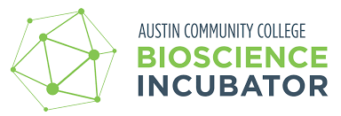



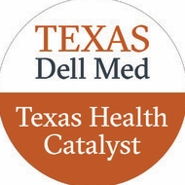








Infrastructure is in place for life sciences innovation
NON-EXHAUSTIVE
Research and development is growing
Active regional innovation support network
$9.4B
Research and development dollars from businesses in the Austin region¹; academic R&D represents another ~$1B with ~20% currently focused on life sciences
Incubators
140+
Life sciences patents developed per 1M people in the Austin region, ranking 14th among the top 50 metros (MSAs) in the US
Tier 1
Research university with UT Austin in Central Austin with top 10 programs in engineering and computer sciences; Texas State recently exceeded $100M in research expenditures in FY22²
Accelerators
Funding is abundant with a demonstrated ability to scale innovation
6th
137%
15th
Investment support
in overall VC dollars per capita amongst the top 50 MSAs ³ (2020 – 2022)
Growth in life sciences VC in Austin between 2018-2023
Largest investor city for angel and VC investors funding life sciences startups
1. NSF HERD, 2021
2. Texas State website
3. For percent change, compared averages of 2018-2019 to 2022-23 to account for large annual fluctuations

Slide 10




Vibrant region with continued growth
Cultural events that attract innovation
The Austin region is home to the annual SXSW conference, Life Science and Healthcare Innovation Summit, and a series of other key events to convent life sciences thought leaders
The Austin region is a good place to live and do business
Burgeoning Innovation District
Developing Innovation District in the heart of the Central Business District with real estate with close proximity to the city’s major research university, development of two new hospitals and an upcoming effort to revitalize I-35 and further enhance vibrancy
The Austin region has experienced GDP growth of 57% from 2016-2021, highest among select peers and has been ranked the top place to live in Texas according to US News and World Report’s 2023 survey
There are ample business incentives including the state-level Jobs, Energy, Technology and Innovation program that reduces property taxes for new manufacturing, research and development facilities
Dynamic regional culture
The Austin region boasts the highest parks per capita among peer cities¹, a live music hub with multiple annual music festivals, and eight James Beard award semifinalists in 2024
1. Peers include Dallas, Houston, San Diego, Boston, Raleigh-Durham, Charlotte and Nashville
Source: Lightcast, Trust for Public Land, web search

Slide 12




Specialization in MedTech in the region can serve as a catalyst for growth
Non-exhaustive
Ecosystem partnerships and interdisciplinary research that can fuel innovation
Workforce specialization is building
Non-exhaustive
The Austin region has higher concentration¹ of orthopedics-related jobs than the US
Job postings in NeuroTech in the region outsize other therapeutic areas within MedTech (e.g., cardio MedTech)
Texas Robotics partners with the private sector to explore research topics through shared infrastructure and capabilities
Example partners include sparkcognition, Fox Robotics, Google, Amazon and more
Funding momentum in the region
Over $440M in VC funding in healthcare devices and supplies in the past five years, specifically within therapeutic devices and diagnostic equipment
Dedicated capital firms to the growth of med devices and diagnostics headquartered in Austin (e.g., Revival Healthcare Capital)
Mulva Institute was launched at Dell Medical School with a $50M gift
Incubators in the region with healthcare applications, including investment in prosthetics companies and diagnostics
1. Based on number of unique job postings; comparing 2018 and 2023 (latest full year available); search terms available in the Appendix
Source: Pitchbook, Lightcast, web search

Slide 13



The Austin region is home to world class AI-enabled life sciences and digital health capabilities
Non-exhaustive
Talent pool is highly specialized in tech-related fields
Regional assets to propel innovation
The Austin region is 1.5x more specialized in data scientists occupations than national average with demand growing at ~30% and 2x more specialized in Operations Research Analysts
Fastest academic supercomputer in the country
Research portfolio with over $108M in funding, with 130+ faculty
Funding momentum in the region
8th ranked computer science, engineering and artificial intelligence programs in the country; UT commitment to make 2024 the “Year of AI”
Over $5B of venture capital funding¹ allocated to Artificial Intelligence and Machine Learning in the Austin region in the past five years
$740M of VC funding for Healthcare Technology Systems, highest among life sciences-specific areas
9/10
9 of the 10 highest revenue US tech companies call the Austin region home
1. Pitchbook data, 2018-2023
Source: Pitchbook, Lightcast, web search

Slide 14

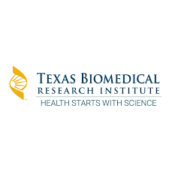
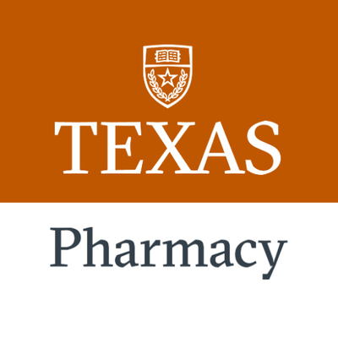
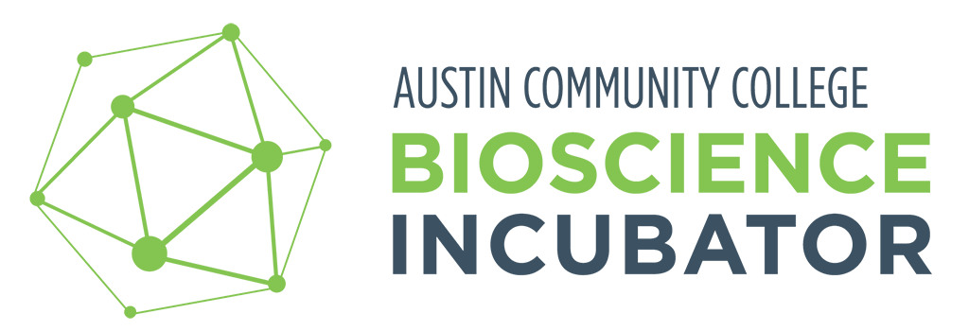
The Austin region has the groundwork for accelerate biologics
Non-exhaustive
Abundance of research to enhance innovation
Regional assets propelling innovation
Connection to the I-35 corridor, including less than 50 miles from San Antonio which boasts several key biopharma research facilities
Texas Biologics, launched in 2022 at UT Austin as a translational research center focused on biologic therapy innovation,
Connection to the I-35 corridor, including less than 50 miles from San Antonio which boasts several key biopharma research facilities
7th best pharmacy program in the country (US News & World Report) at a Tier 1 research institution
Top educational programs in biology
The Austin area graduates over 1,000 biology students and nearly 500 biochemistry students, biophysics and molecular biology with higher specialization than the US (LQ of 3.7 and 1.3, respectively)
Collaborative wet lab space, start up support and industry partnerships through regional resources
Source: Pitchbook, Lightcast, web search

Slide 15


The addition of new clinical spaces and programming can further enhance efforts underway around clinical trials and life sciences enablement
Non-exhaustive
$2.5B
Investment to launch the University of Texas Medical Center, including a state-of-the-art specialty hospital
#1 top ranked cancer center MD Anderson will expand its footprint to Austin; in FY23, MD Anderson spent over $1.2B on research
Texas Health Catalyst aimed at supporting the translation of promising ideas to products that improve health, supporting the 12+ patents from Dell Med inventors​
Source: Pitchbook, Lightcast, web search

